Slide 1
The Spacetime Nature of Innovation
Ben Koo
benkoo@Tsinghua.edu.cn
March 3rd，2020
Notes:
今天的主题是“区块链启发的新产业范式”

Slide 2
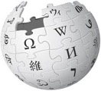

The most“strategic” metrics
Trust-worthiness
Time
Space

Slide 3
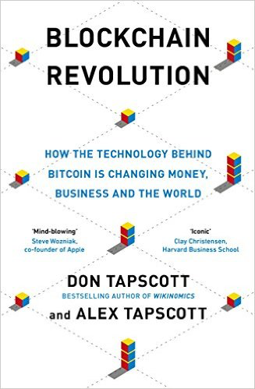
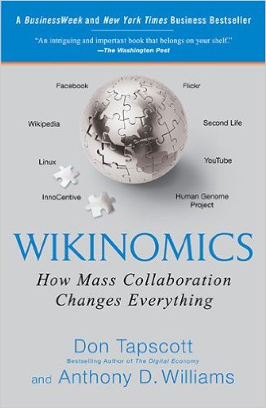
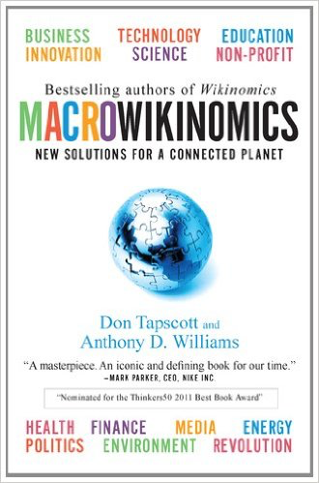
Innovation over Spacetime

Slide 4
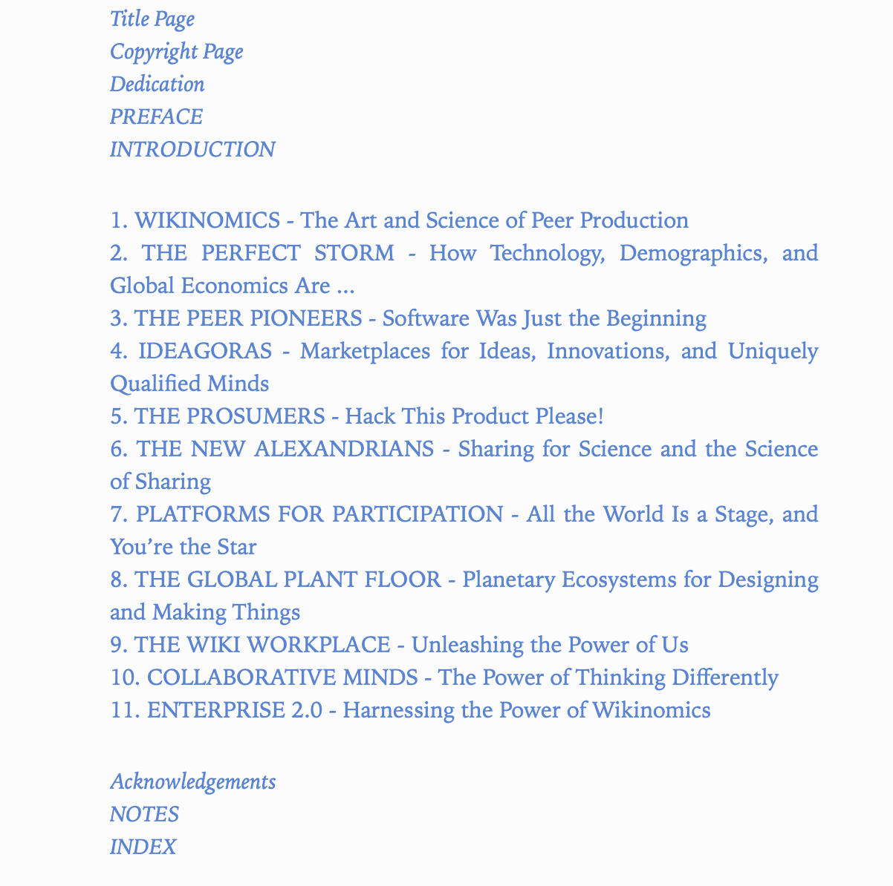
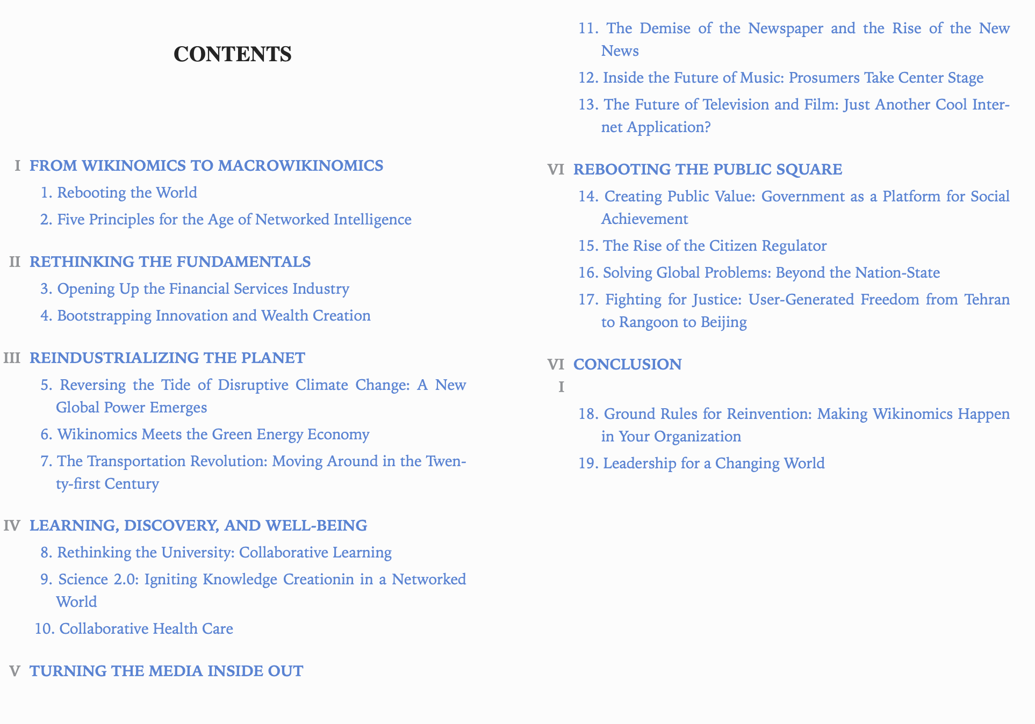

Slide 5
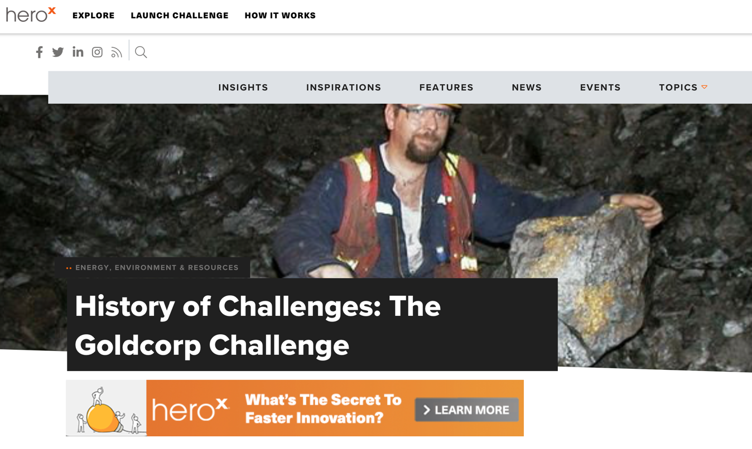
Mining Gold the Wikinomics Way
Since they did not know where to begin looking and any exploration process was likely to be time-consuming and expensive, Rob McEwen - Goldcorp's CEO - decided to do something bold. Inspired by an MIT conference he attended in 1999 - where the story of how Linus Torvalds used the Internet as a collaborative resource to build the Linux software operating system - McEwen decided to crowdsource a solution.
https://www.herox.com/blog/408-history-of-challenges-the-goldcorp-challenge

Slide 6
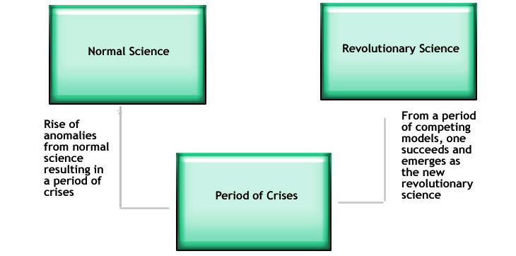
New Vocabulary must be born to signify the changes from Normal to Revolution
http://structural-communication.com/Articles/Anatomy-metaphor-stclair.html

Slide 7
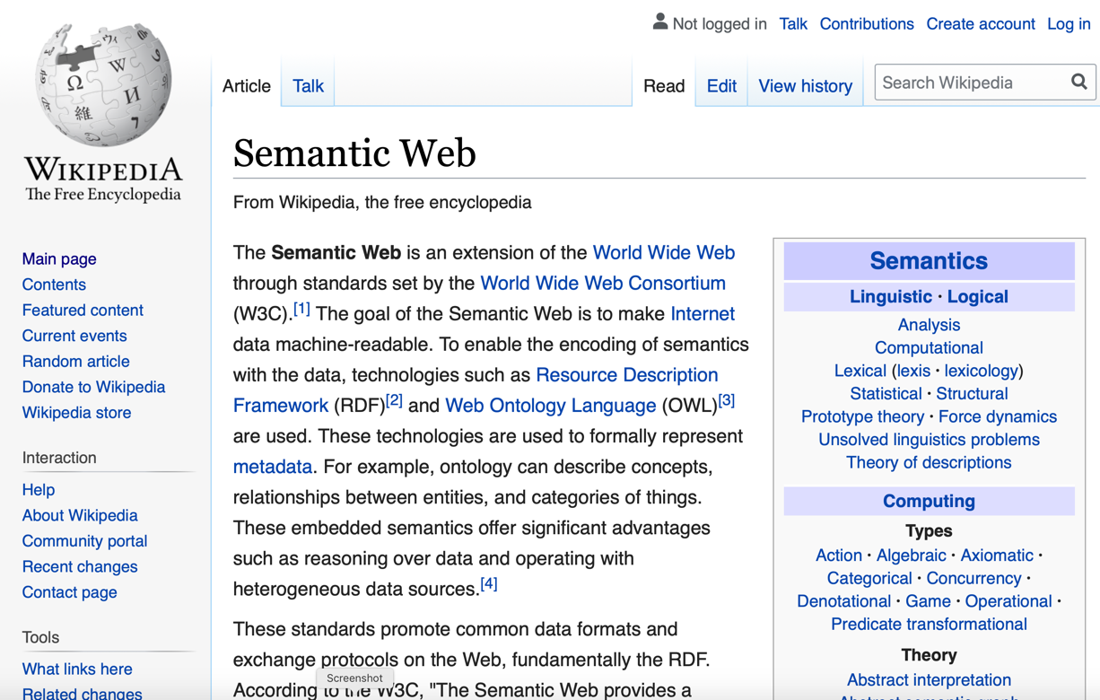
Managing Vocabulary Globally?
https://en.wikipedia.org/wiki/Semantic_Web

Slide 8
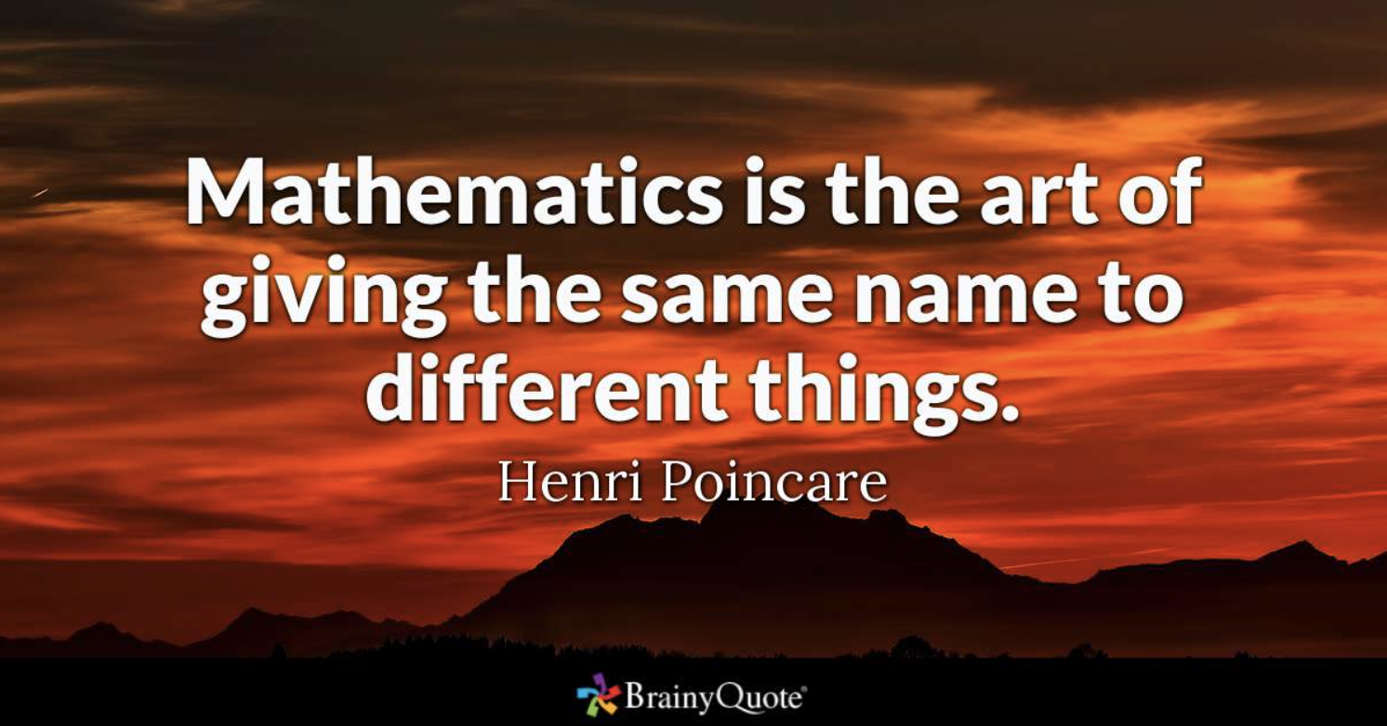
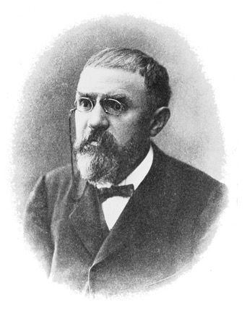
Name Space Management
Henri Poincare was founder of modern topology
and the first to present the Lorentz transformations which
eventually lead to the theory of Relativity.
- Wikipedia
https://www.brainyquote.com/quotes/henri_poincare_208086

Slide 9
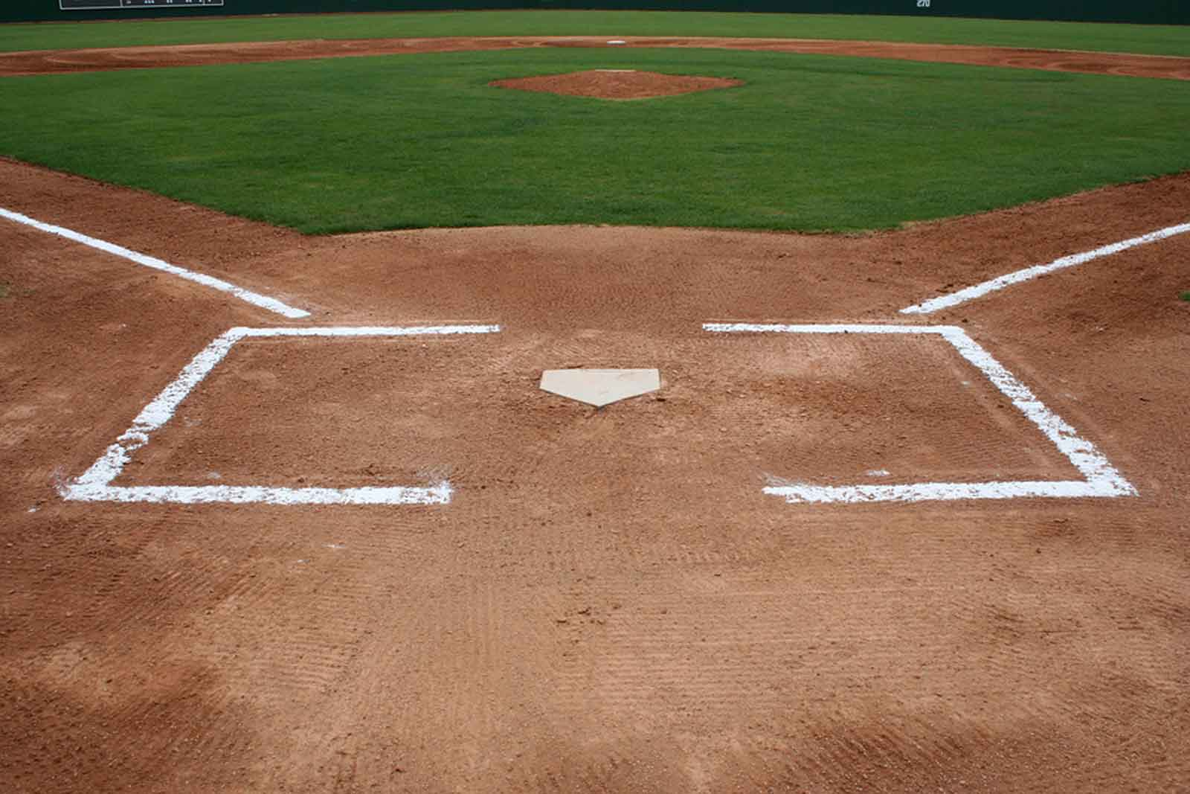
Ontological Metaphor(本体比喻 )
Relate abstract concepts and ideas in terms of “well-known” objects.
A “Home”base
http://neousssabaseball.com/2wsx3edc/wp-content/uploads/2012/09/Baseball-Field-at-Home1.jpg

Slide 10
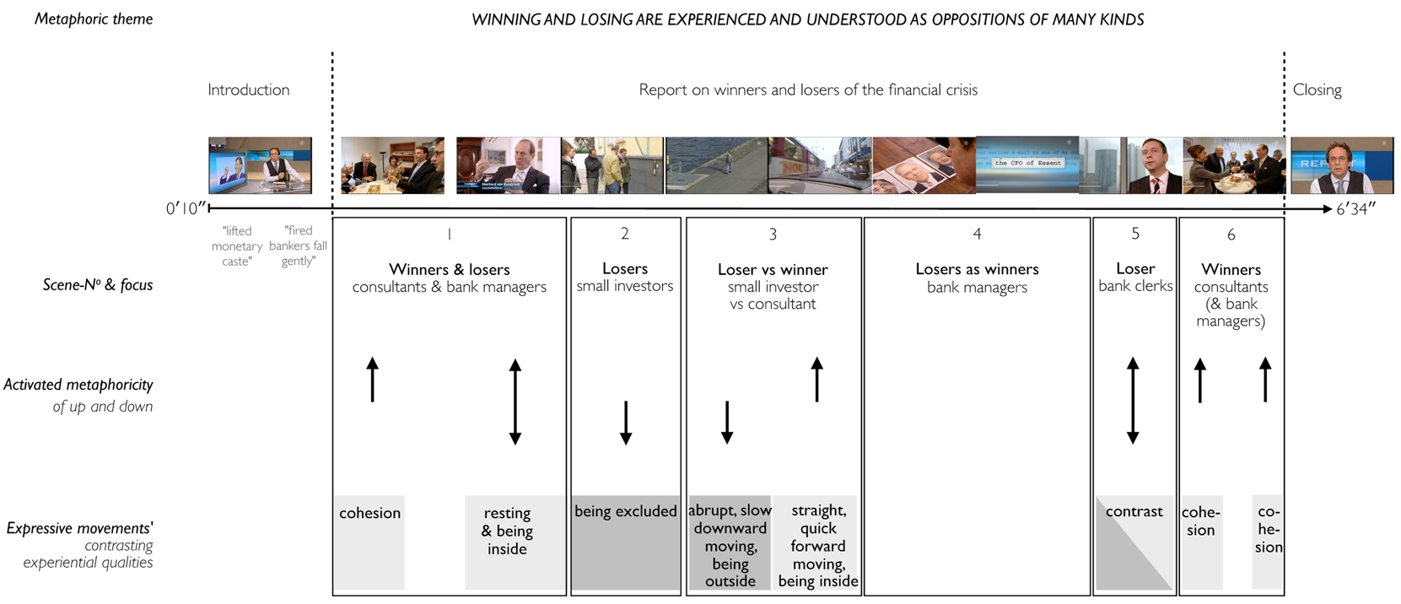
Orientation Metaphor(空间比喻)
Audio-visual metaphors of the financial crisis: meaning making and the flow of experience
http://www.scielo.br/scielo.php?script=sci_arttext&pid=S1984-63982015000200311

Slide 11
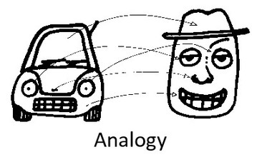
System Metaphor （系统比喻)
http://www.eoht.info/page/Analogy

Slide 12
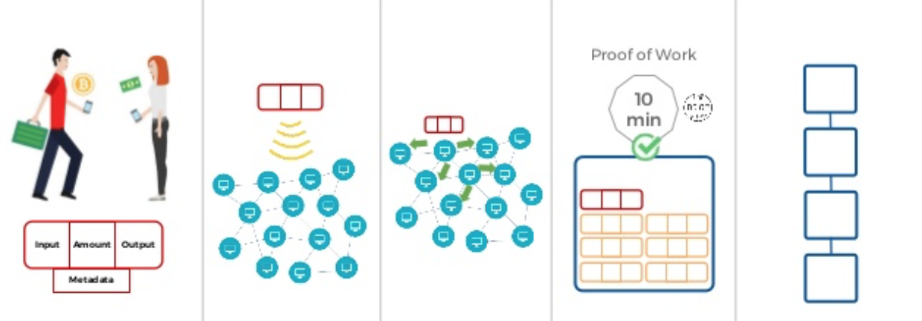
How Blockchain Works
Human transactions witness event sequences.
Time
Human Transactions
Broadcast Trans. Records
Replicate Trans. Records
Linked onto a ”Blockchain”
Records in a Block
Timestamp
Data replication node should be administratively independent
https://es.slideshare.net/coiicv/joaqun-moreno-blockchain-practice-lead-de-globant-semanainformaticacom
Notes:
先和大家讲述一个主要的背景，从图中我们可以看到交易记录越公开越不容易被篡改。那么可得出交易数据链的长度与计算力，决定可信度这一概念换句话说我的交易数据链越长，计算力越多代表着可信度越高。

Slide 13
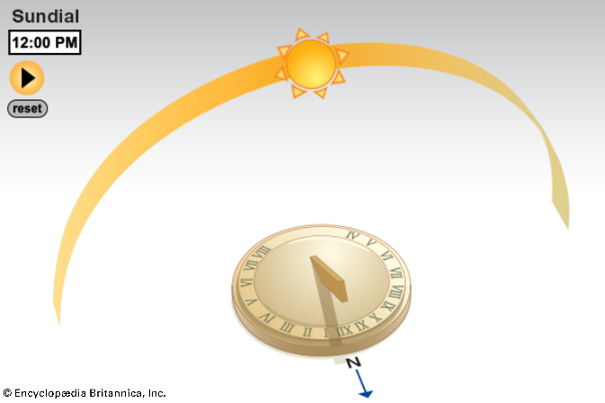
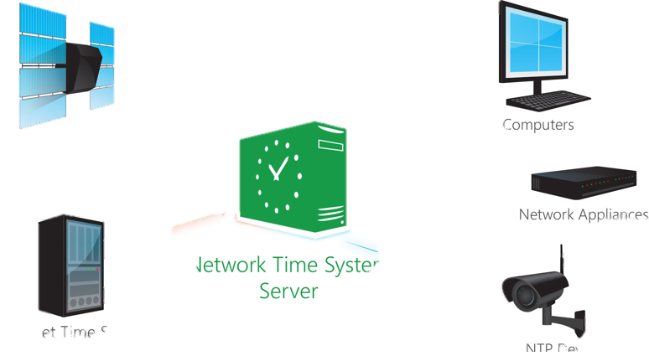
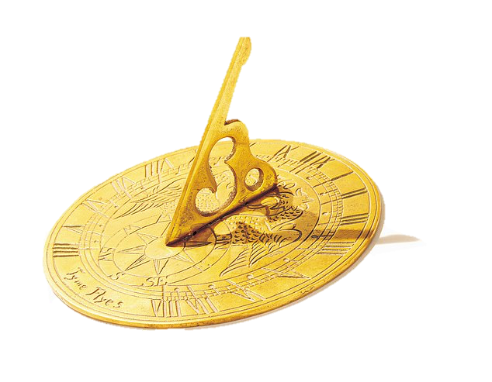
Blockchain is the first Trust-worthy Global Clock
Sundial is the only “trust-worthy” global clock before 2008
NTP 图像来源：https://thecustomizewindows.com/2019/03/esp32-arduino-get-time-date-ntp-server/
日晷图像来源：https://www.dailymail.co.uk/news/article-6727419/Top-sundial-expert-sheds-fascinating-light-art-form-fears-slipping-shadows.html

Slide 14
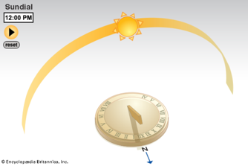
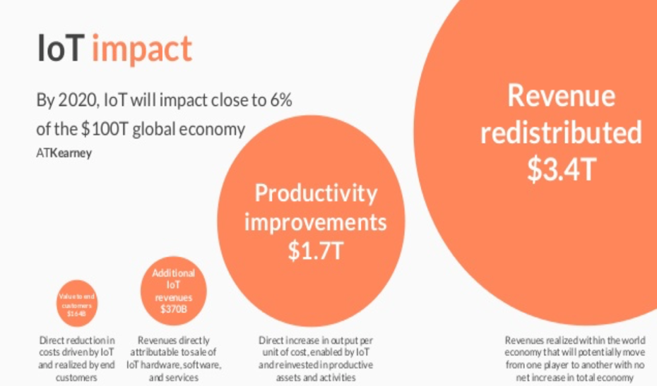
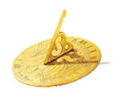
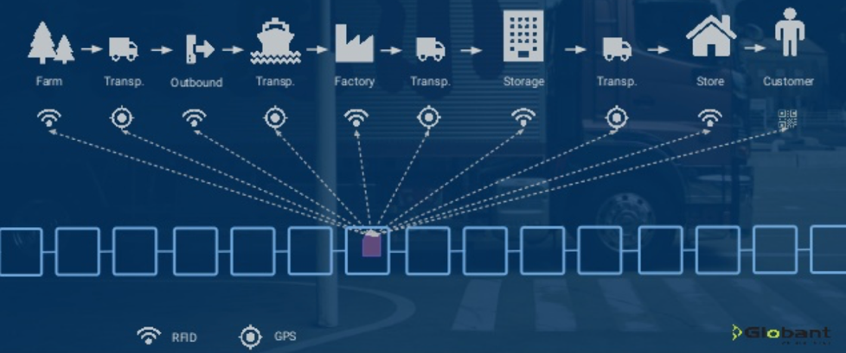
Trust-worthy Data：Data with verifiable Physical Meaning
Blockchain as Sundial
Notes:
这就回到当时的区块链了，为什么我们要大力发展区块链、物联网？因为区块链和物联网给数据资产的度量衡提供了时间、空间的可观测数据进而让我们建立了可信机制

Slide 15
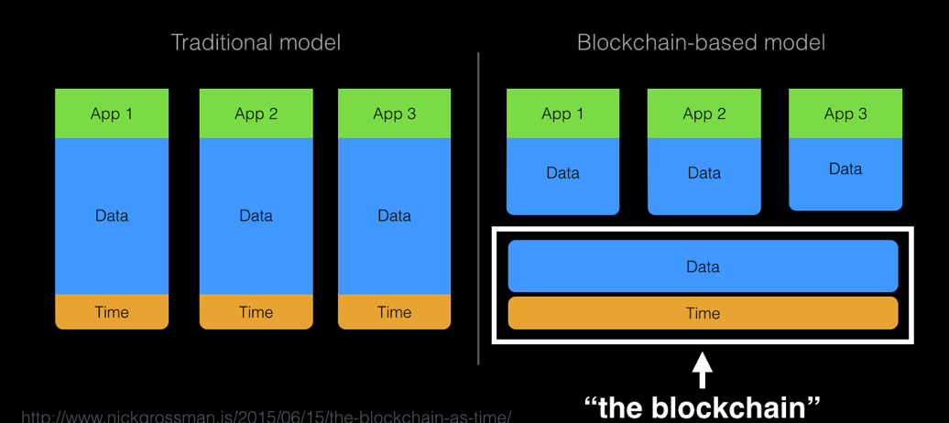
Blockchain: ”Centralized” Globally Shared Clock
Nick Grossman: https://www.nickgrossman.is/2015/the-blockchain-as-time/
Notes:
在时间上，我们把区块链定义成是一个分布于全球范围的数字时钟，他可以对数据内容赋予一个时间上的标识即打上时间戳。时间问题得以解决。

Slide 16
Blockchain：An immutable Transactional Database
Blockchain:Trust-Worthy Data Service
Data: Safety and Liveness

Slide 17
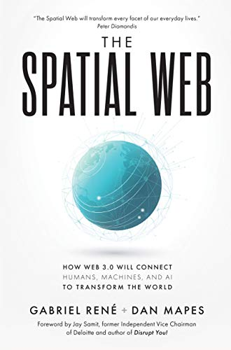
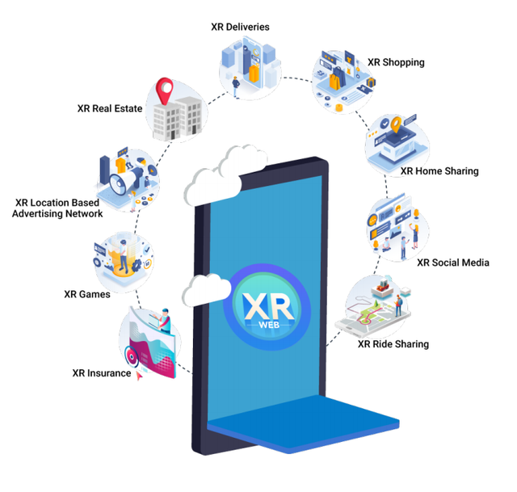
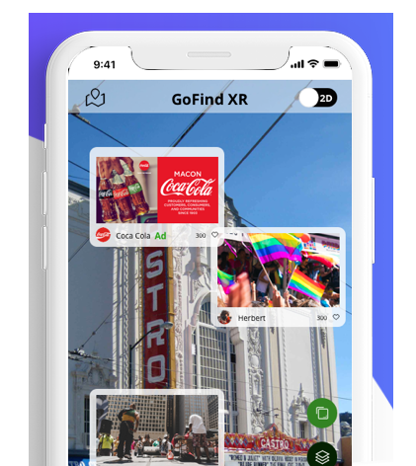
Spatial Web = Web 3.0
XR is a decentralized network protocol that transforms our Web physical space into a secure, encrypted three-dimensional web space where content and applications can be projected, viewed, and transmitted. XR Web creates the basic infrastructure and SDK where various applications can be created, such as XR gaming, social media, real estate, advertising, trip sharing, home sharing, retail insurance.
Image credits: https://www.xrweb.network/
Notes:
下面我们再引入以下空间网的概念，空间网=对数据赋予时间与空间的标示

Slide 18
Spatial Web = The API of Spacetime
Spatial Web = Annotating time and space
Intelligent City and Businesses
Image credits: http://verses.io
Image credits: http://verses.io
Global Supply Chain
From
Mining Sites
Image credits: http://verses.io
Image credits: http://verses.io
Notes:
这几张图可以对空间网的概念有大致的了解认知

Slide 19
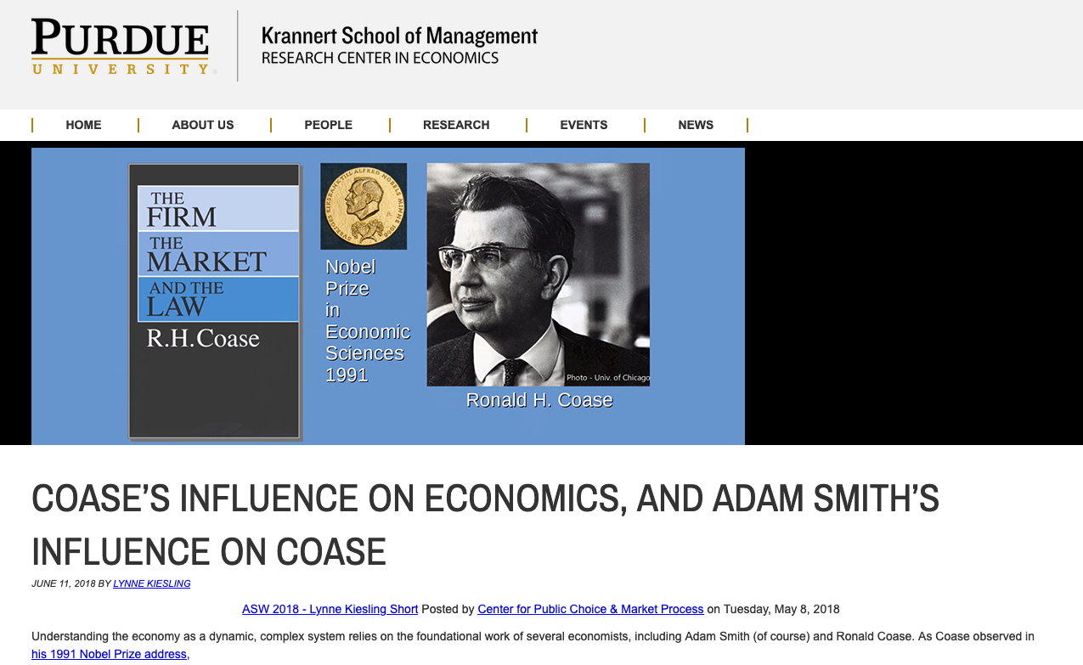
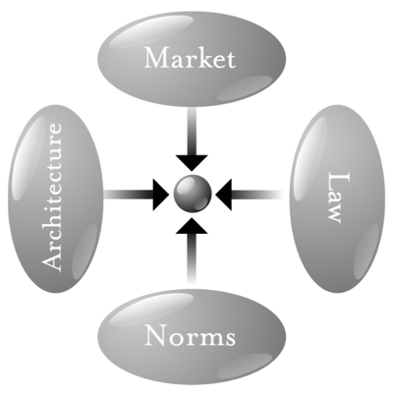
Chicago School: The paradigm of private currency
Image Source:
P 123 of Code V2 by L. Lessig
Notes:
由上，我们当前的经济其实是“账户经济”，倘若记账成本低于生产成本？那么记账就是最简单最盈利的事情了

Slide 20
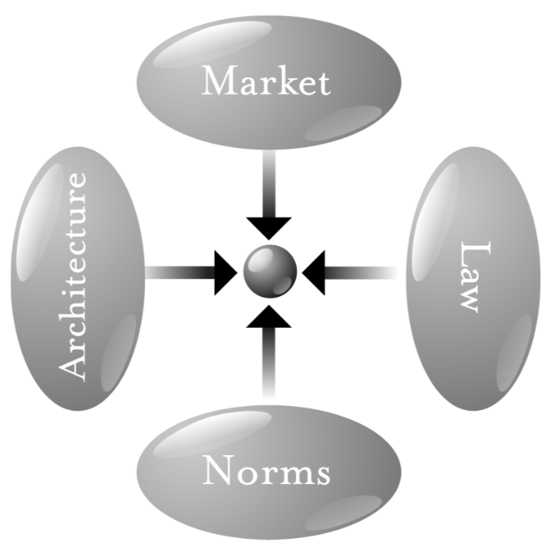
Governance in Spacetime
市场
Far
Space
Near
架构
执法
Before Time After
常态
Image Source: page 123 of Code V2 by L. Lessig
Notes:
我们这一套体系最基础的模型就是基于芝加哥学派所划出的产业发展四力模型而出的。

Slide 21
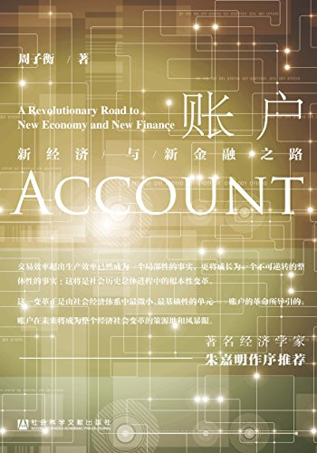
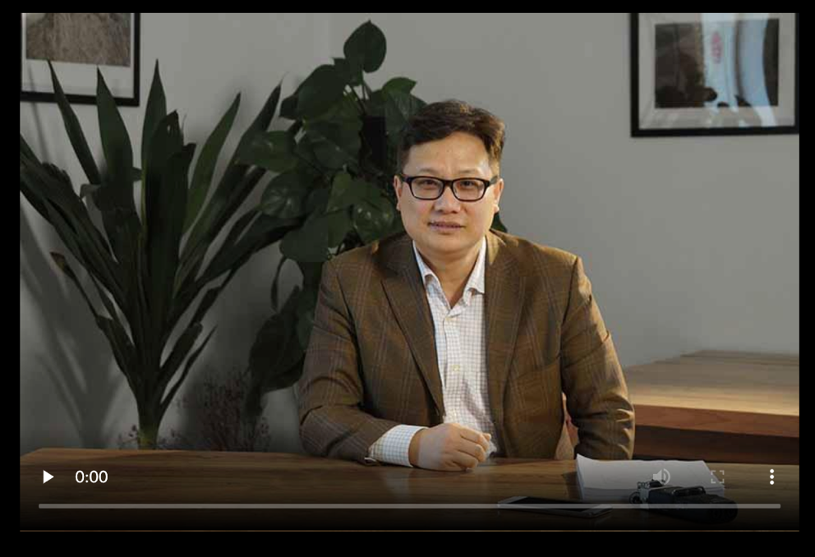
Account-based Economy is the new paradigm
http://dushuren123.com/bookmov/video/share.jsp?id=648112690
Notes:
因为这前五大、二十大的上市公司是管理数据的数据公司，所以管理数据的他们最有钱。
引用Peter Bakker的话“科学家不能改变世界，但会计师可以。”
上述的那些公司就是数据的会计师公司，现在我们所在的时代是数据资产时代，我们的所有资产都在账户之中。谁管理我们的账户，那么谁就是会计师。

Slide 22
Liveness Condition of Economic Activities
Daily Active User (DAU)：（日活量）
How ledger is being updated on a daily basis
Measuring Liveness of a community
Number of transactions processable by machine： Transaction Per Second (TPS)
Technical Limitation：高性能系统可达 1 M+ TPS
Bitcoin 7 TPS
Ethereum 20 TPS
Both systems are not practical for commodity trades
Most of the exchanges are “centralized”

Slide 23
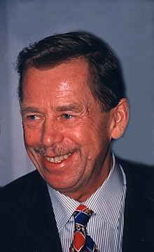
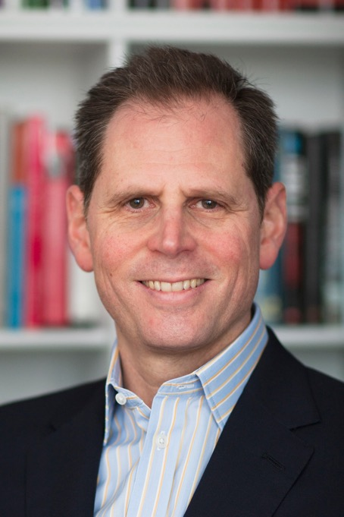
Blockchain vs. Big-man Society
市场
架构
执法
“Former President of Czech Republic：“The essence of life is infinitely and mysteriously multiform, and therefore it can not be contained or planned for, in its fullness an variability, by any central intelligence.”
From : Page 295-296 Beinhocker’s. Origin of Wealth
常态
Eric D. Beinhocker
Notes:
我们这一套体系最基础的模型就是基于芝加哥学派所划出的产业发展四力模型而出的。

Slide 24
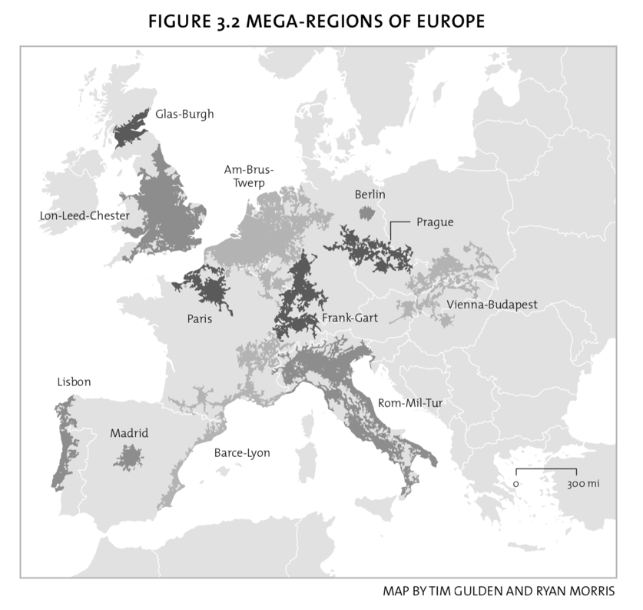
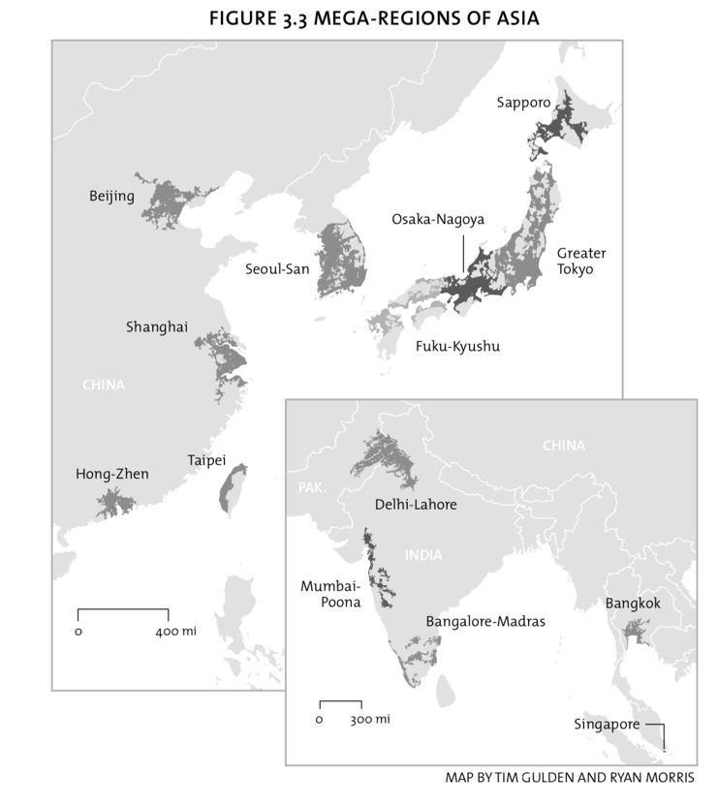
Spatial Distribution of Human Capital
Image Source: Who’s your city, by Richard Florida

